Slide 1

Programming Two (csc7051)
Aidan McGowan
Command line programming
- A Review Exercise

Slide 2
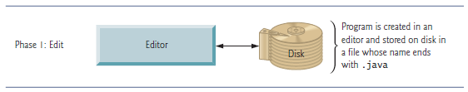
Creating a Java source file
Using a basic text editor such as NotePad (i.e. not an IDE) create a simple Test.java class. (It should contain a main method that outputs “Hello Programming 2”).

Slide 3
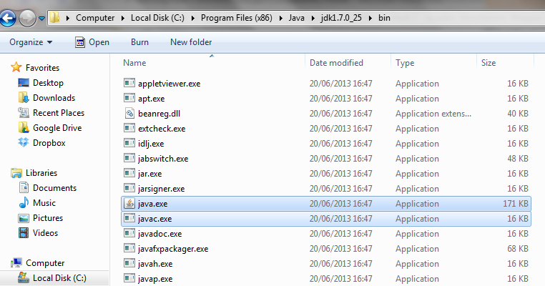
java.exe and javac.exe
After installing your Java version software, typically the JDK directory will have the structure shown below.
The bin directory contains both the compiler (javac.exe) and the launcher (java.exe)

Slide 4

Compiling the Java Source code
To compile you will need to run the javac executable.
You can run Java applications just fine without setting the PATH variable. Or, you can optionally set it as a convenience.
If you do not set the PATH variable, you need to specify the full path to the executable every time you run it, such as:
  C:\”Program Files”\Java\jdk1.7.0\bin\javac Test.java
Notes:
For example if you had a java file called Test.java in folder Javaland then …
C:\Javaland>"..\Program Files\Java\jdk1.8.0_25\bin\javac" Tester.java
"Program Files (x86)\Microsoft Office\Office14\winword.exe
"Program Files"\Java\jdk1.8.0_25\bin\javac
C:\Javaland>..\"Program Files (x86)\Microsoft Office\Office14\excel.exe"

Slide 5

Setting the PATH
Set the PATH variable if you want to be able to conveniently run the executable (javac.exe, java.exe, javadoc.exe, and so on) from any directory without having to type the full path of the command.
Open (windows machine)
  Control Panel → System → Advanced System Settings → Advanced (TAB) → Environmental Vars → (add or edit PATH variable)
e.g. C:\Program Files\Java\jdk1.7.0\bin
To check the PATH is set to the correct Java version open a command window and enter :

Slide 6
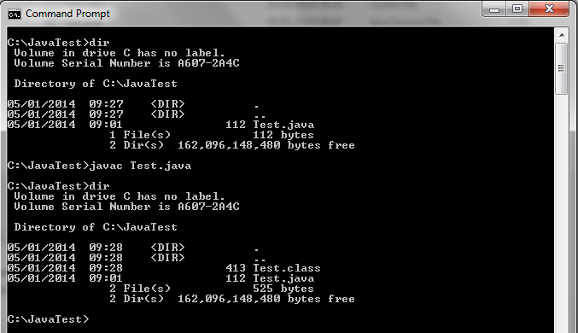
Compiling the Java Source code
Calling the javac executable to compile the class
The compiled class (bytecode)

Slide 7
Execute
The JVM is invoked by the java command.
For example, to execute a Java application

Slide 8
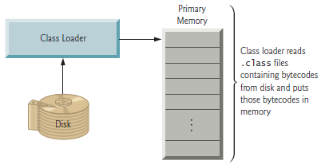
Execute – under the hood….
Class Loading
The JVM places the program in memory to execute it—this is known as loading. The JVM’s class loader takes the .class files containing the program’s bytecodes and transfers them to primary memory. The class loader also loads any of the .class files provided by Java that your program uses. The .class files can be loaded from a disk on your system or over a network (LAN or the Internet).

Slide 9
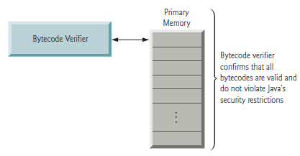
Execute – under the hood… bytecode verifier
As the classes are loaded, the bytecode verifier examines their bytecodes to ensure that they’re valid and do not violate Java’s security restrictions. Java enforces strong security to make sure that Java programs arriving over the network do not damage your files or your system (as computer viruses and worms might).

Slide 10
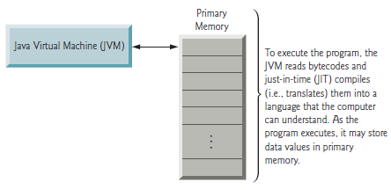
Execute – under the hood…
The JVM the executes the program’s bytecodes, thus performing the actions specified by the program.
Notes:
In early Java versions, the JVM was simply an interpreter
for Java bytecodes. This caused most Java programs to execute slowly, because the JVM
would interpret and execute one bytecode at a time. Some modern computer architectures
can execute several instructions in parallel. Today’s JVMs typically execute bytecodes using
a combination of interpretation and so-called just-in-time (JIT) compilation. In this
process, the JVM analyses the bytecodes as they’re interpreted, searching for hot spots—
parts of the bytecodes that execute frequently. For these parts, a just-in-time (JIT) compiler—
known as the Java HotSpot compiler—translates the bytecodes into the underlying
computer’s machine language. When the JVM encounters these compiled parts again the faster machine-language code executes. Thus Java programs actually go through two compilation phases—one in which source code is translated into bytecodes (for portability
across JVMs on different computer platforms) and a second in which, during execution,
the bytecodes are translated into machine language for the actual computer on which the
program executes.

Slide 11
Exercise
Using just a text editor create a Java program that when it runs will output the values 1 to 50 (inclusive)
It should contain a main method that invokes another method with the upper limit number (50) passed as a parameter argument.
Compile from command line using the javac.exe
Run from command line using java.exe

